Slide 1

Computational Fluid Dynamics Lab Project – Intermediate Presentation
Group 02
Kislaya Ravi
Ravil Dorozhinskii
Raghavendra Kamath

Slide 2
Outline
Topic and Inspiration of Work
Pre-processing of geometry
Using OpenFoam to generate grids
Operations to filter out non-fluid lattices
Changes in code
Present state of project
Further work

Slide 3
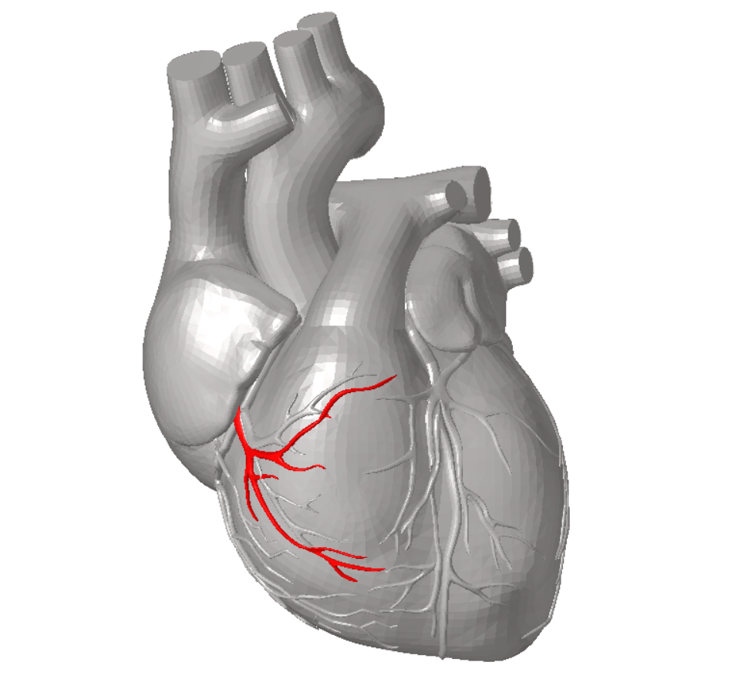
Topic
SIMULATION OF BLOOD FLOW THROUGH ARTERY USING LATTICE BOLTZMANN METHOD IN UNSTRUCTURED GRIDS
Source: http://impression3d.laposte.fr/en/various/3-colors-anatomical-heart

Slide 4

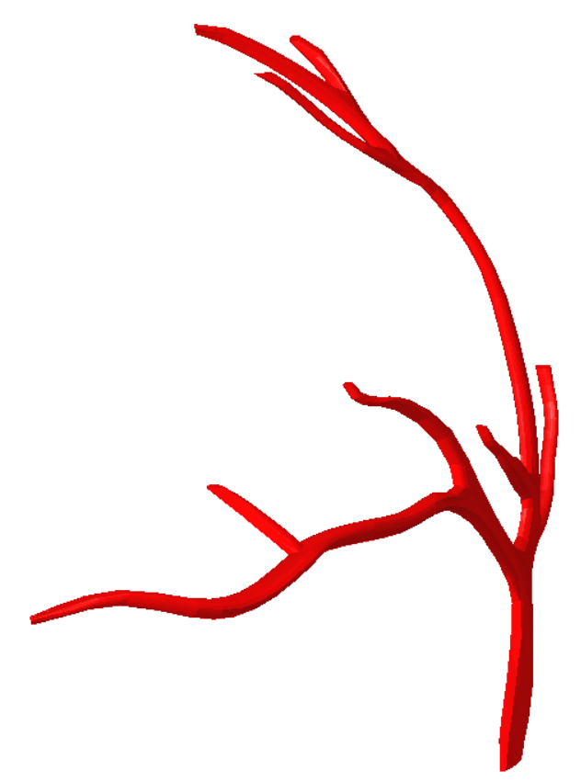
Our Geometry
Source : http://impression3d.laposte.fr/en/various/3-colors-anatomical-heart

Slide 5
Inspiration
Comparison of full rectangular box meshing vs mesh in required area only
If we mesh full domain, then memory waste for storing values
There are some methods to solve this kind of situation
In our project we use UNSTRUCTURED GRID approach
The source of inspiration for our project is following paper:
LBMHexMesh: an OpenFOAM based grid generator for the Lattice Boltzmann Method (LBM), Andrea Pasquali, Martin Schonherr, Martin Geier, Manfred Krafczyk
Rectangular Box Size(mm) | 22X20X18
Mesh Size(mm) | 0.05
Number of Nodes(rect. box) | 63360000
Number of concerned nodes | 148745
Percentage of total domain | 0.23%
Notes:
Talk about complicated 3D
Also compare the number of elements when we use a box vs Unstructured Grid with same mesh size
We don’t waste memory and CPU time by using Unstructured grids

Slide 6
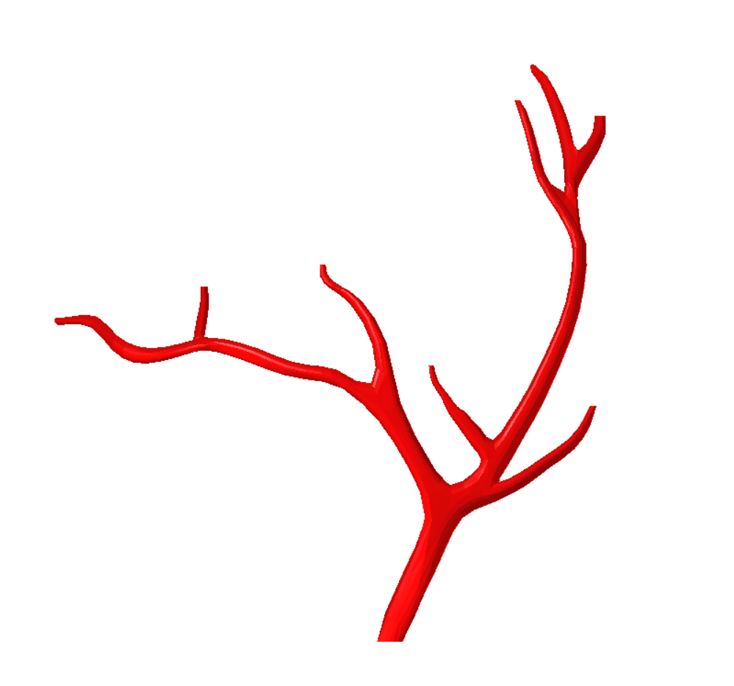
Multiple Boundary Conditions
Outlet 7
Outlet 6
Outlet 8
Outlet 3
Outlet 2
Outlet 1
Outlet 4
Outlet 5
Inlet
Source : http://impression3d.laposte.fr/en/various/3-colors-anatomical-heart
Notes:
Talk about complicated 3D
We don’t waste memory and CPU time by using Unstructured grids

Slide 7
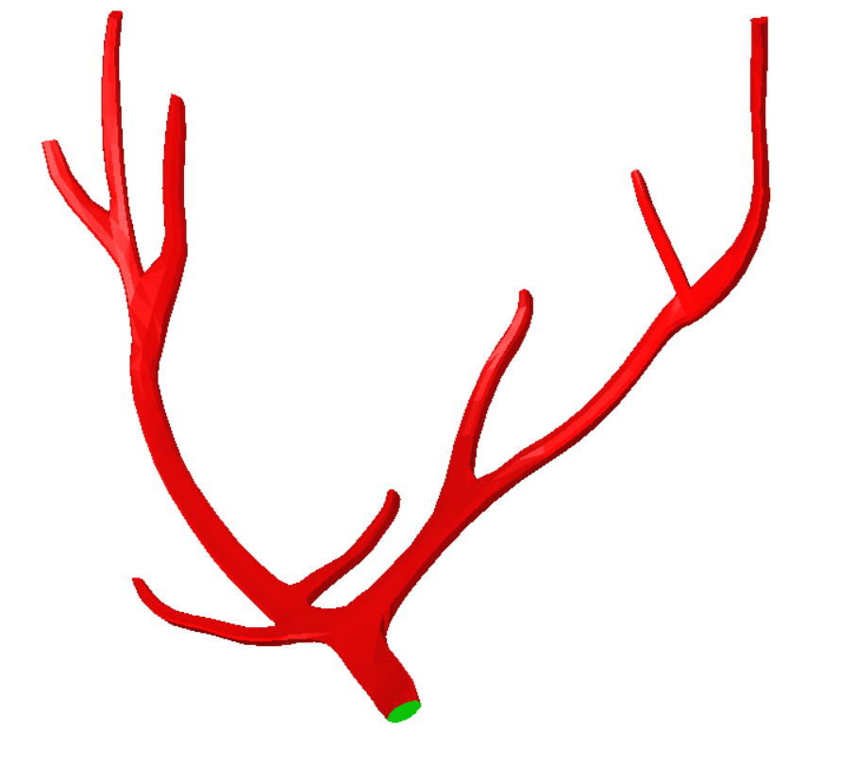
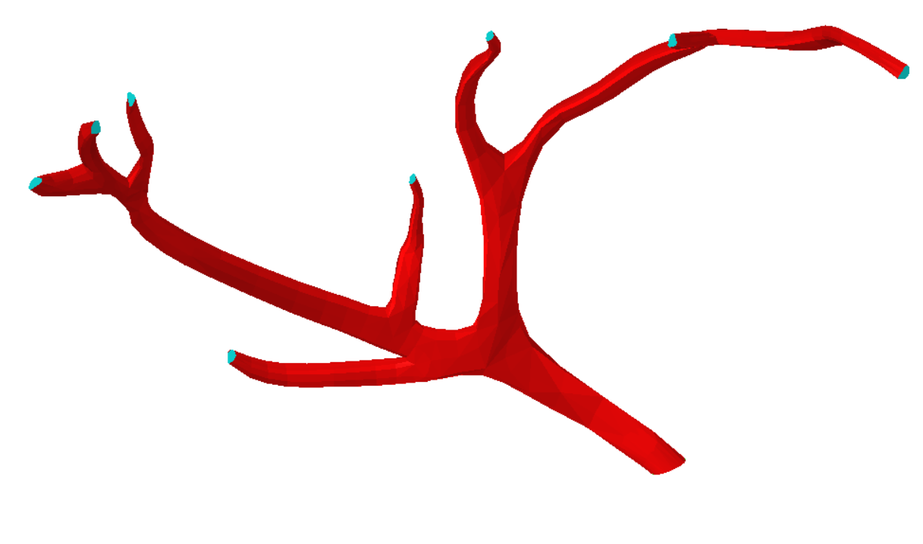
Multiple Boundary Conditions
INLET – Inflow condition OUTLET - Outflow condition WALLS – No-slip conditio
Source : http://impression3d.laposte.fr/en/various/3-colors-anatomical-heart
Notes:
Talk about complicated 3D
We don’t waste memory and CPU time by using Unstructured grids

Slide 8
Preprocessing of Geometry
Import the .STL file to Hypermesh (closed source but there are opensource alternatives available) to clean up the stl file and get rid of all the irregularities.

Slide 9
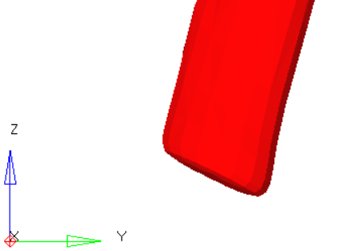
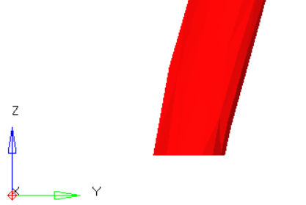
Preprocessing of Geometry
Import the .STL file to Hypermesh (closed source but there are opensource alternatives available) to clean-up the stl file and get rid of all the irregularities.
The inlets and outlets are modified to accommodate for CFD simulation.

Slide 10
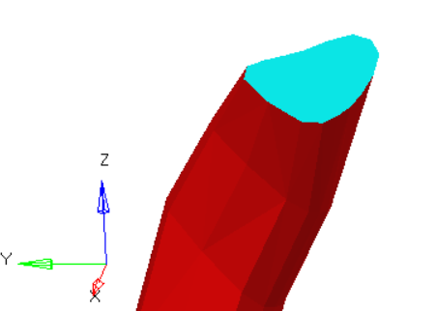
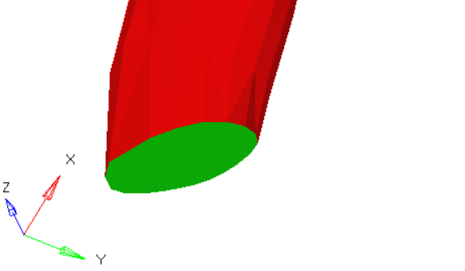
Preprocessing of Geometry
Import the .STL file to Hypermesh to clean-up the stl file and get rid of all the irregularities.
The inlets and outlets are modified to accommodate for CFD simulation.
The inlet, outlets and walls of the artery are tagged in the .STL file for better handling while defining the boundary conditions.

Slide 11
Preprocessing of Geometry
Import the .STL file to Hypermesh to cleanup the stl file and get rid of all the irregularities.
The inlets and outlets are modified to accommodate for CFD simulation.
The inlet, outlets and walls of the artery are tagged in the .STL file for better handling while defining the boundary conditions.
The unit vectors normal to the inlet and outlets are recorded.
The bounding box of the whole domain is defined and all the essential co-ordinates are recorded which will be used in the next step.

Slide 12
Using OpenFoam to Generate Grids
We use OpenFoam (an open-source CFD solver) to generate grids.
Notes:
To generate the mesh the several files (blockMeshDict, snappyHexMeshDict and meshQualityDict) must be modified setting up appropriate values.

Slide 13
Using OpenFoam to Generate Grids
We use OpenFoam (an open-source CFD solver) to generate grids.
We use blockMesh to generate the bounding box mesh
Notes:
Geometry feature extraction from stl-files was done before mesh generation by means of surfaceFeatureExtract.

Slide 14
Using OpenFoam to Generate Grids
We use OpenFoam (an open-source CFD solver) to generate grids.
We use blockMesh to generate the bounding box mesh
We use SnappyHexMesh to remove cells that are outside the fluid domain
Notes:
Geometry feature extraction from stl-files was done before mesh generation by means of surfaceFeatureExtract.

Slide 15

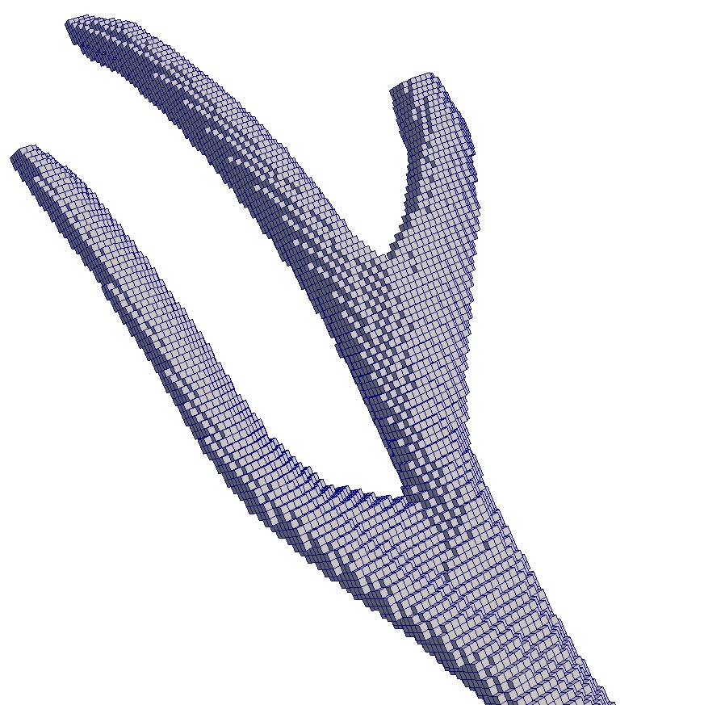
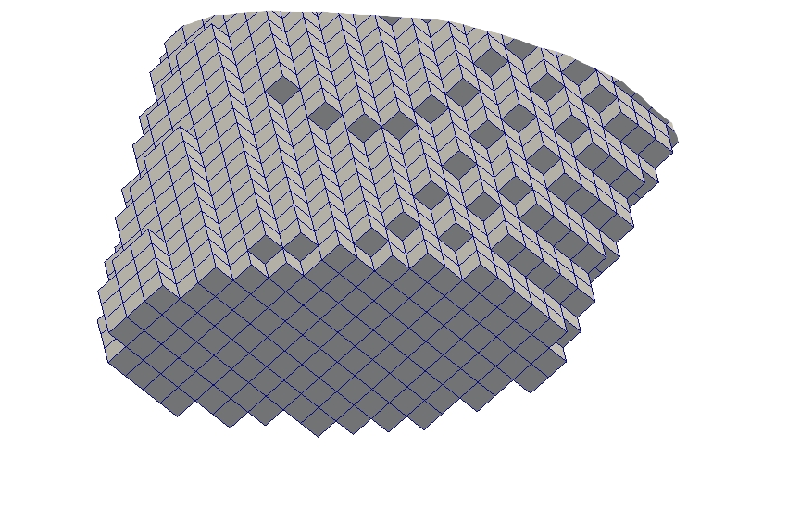
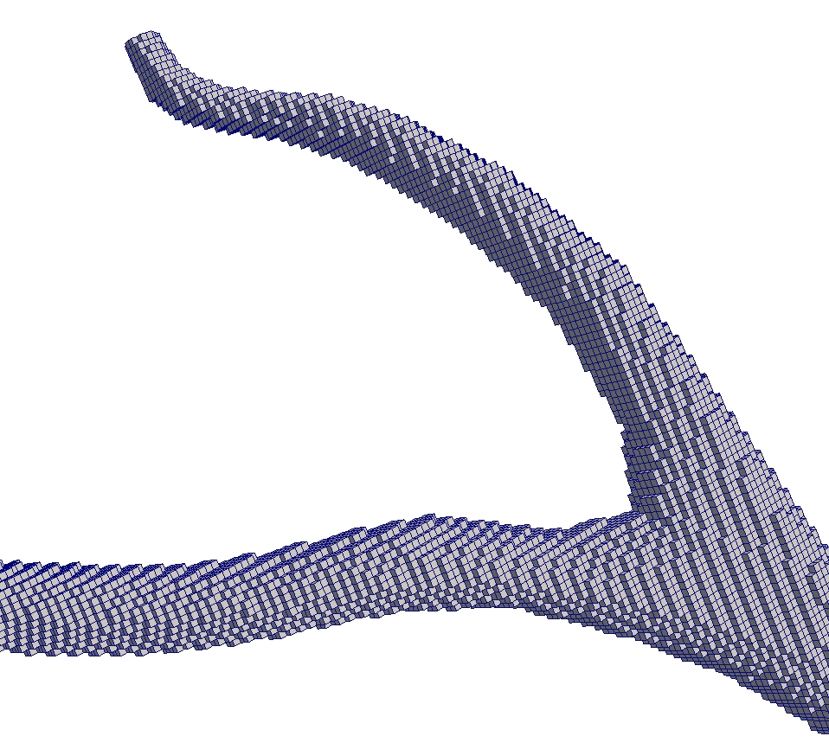
Computational Mesh

Slide 16
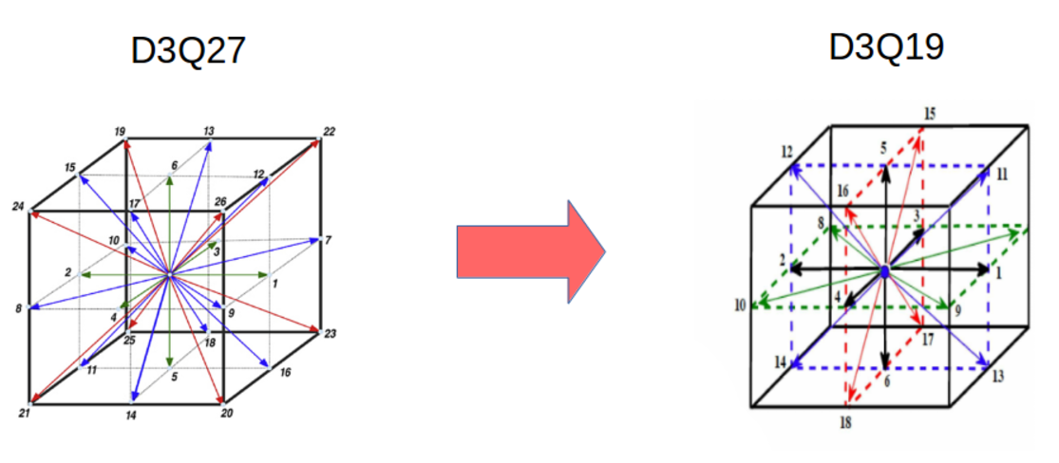
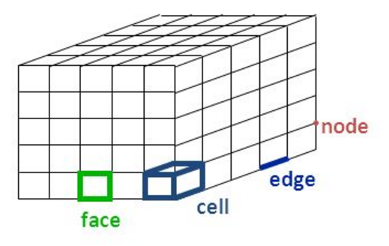
Operations to filter out non-fluid lattices
Custom scripts to process the grid
Finite Volume Mesh Representation
Reference: http://users.ugent.be/~mvbelleg/flug-12-0.pdf
Notes:
Based on the files generated by OpenFoam tools a script was written to convert a finite volume mesh to LBM one. In total, script processes 5 text files, namely: boundary, faces, neighbours, owners and points.

Slide 17
Operations to filter out non-fluid lattices
Custom scripts to process the grid
D3Q27 to D3Q19
Source:https://www.researchgate.net/profile/Fabrice_Golfier/publication/274509601/figure/fig1/AS:294814911352833@1447300760396/Fig-1-Geometry-and-velocity-vectors-description-for-the-D3Q19-lattice.png
https://www.researchgate.net/profile/Sirivatch_Shimpalee/publication/292673877/figure/fig1/AS:358844539654144@1462566613497/Fig-1-The-lattice-structure-of-D3Q27-model-The-weight-factors-w-i-for-the-D3Q27-are.jpg
Notes:
Firstly, the script generates LBM mesh according to the specific scheme D3Q26 (the central index is missed) and only then D3Q26 scheme is converted to the D3Q19 one. Prior filtering with respect to repeats of the neighbour elements and 3D sorting are done because OpenFoam generates unstructured finite volume grid.

Slide 18
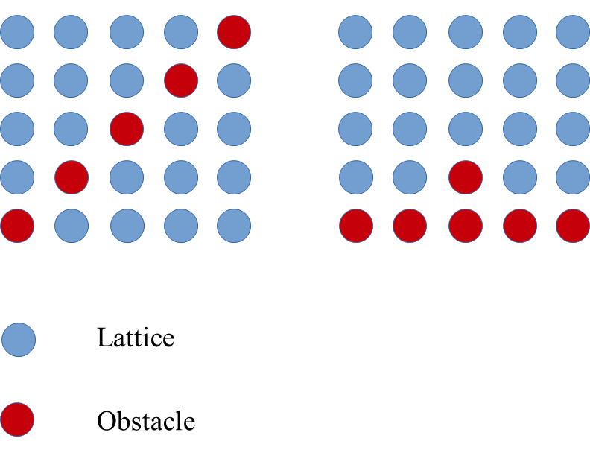
Operations to filter out non-fluid lattices
Custom scripts to process the grid
D3Q26 to D3Q19
Checking correctness of the LBM mesh
Avoiding forbidden combinations
Notes:
the script checks the correctness of the built LBM mesh. Additionally, it is guaranteed that the script generates a LBM mesh without any forbidden combinations.

Slide 19
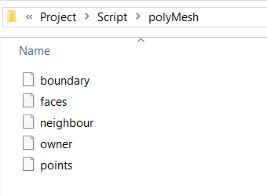
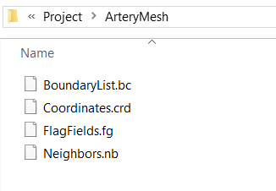
Operations to filter out non-fluid lattices
Custom scripts to process the grid
D3Q26 to D3Q19
Checking correctness of the LBM mesh
Information is sorted and stored as lattice co-ordinates, neighbours and boundary names
Finite Volume > Lattice
python
scripts
Notes:
At the end, the script writes 3 different text files that with information of lattice coordinates, neighbours and boundary names

Slide 20
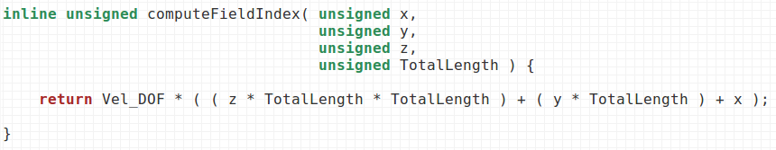
Structured Grid
There is always some explicit formula that we can use to iterate elements

Slide 21

Unstructured Grid
It doesn’t work anymore
There is no formula that we can use!
Solution: We should explicitly assign an ID to each cell

Slide 22
Unstructured Grid
There is no formula that we can use. We should explicitly assign an ID to each cell.
The cell ID us unique for each cell and it help us to find exact location of data in the steaming and collision arrays
Collision Array
...
...
Vel_DOF * aFluidCell.getID()

Slide 23
Changes in the code
Flexibility to handle any type of complex geometry
Notes:
The code is modified to adapt to our application.
The initLB function was changed since it’s getting information from the text files. One of the flexibilities which we included in our code is that our code can take multiple combinations of boundary conditions. This makes our code highly flexible to various kinds of boundary condition variation. The function generates both a vector of “BoundaryConditions” objects (DataStructure.h: line 207 - 221), flag flied and fluid domain vector during the file processing. It’s worth mentioning that the flag filed is filled by IDs that was assigned individually to each “BoundaryConditions” object in the current implementation. That decision allows us to assign unique inflow boundary conditions to different boundaries

Slide 24
Changes in code
Flexibility to handle any type of complex geometry.
Saving computation by iterating through the domain only once storing the fluid domain and iterating through for rest of iteration
Notes:
The code is modified to adapt to our application.
The initLB function was changed since it’s getting information from the text files. One of the flexibilities which we included in our code is that our code can take multiple combinations of boundary conditions. This makes our code highly flexible to various kinds of boundary condition variation. The function generates both a vector of “BoundaryConditions” objects (DataStructure.h: line 207 - 221), flag flied and fluid domain vector during the file processing. It’s worth mentioning that the flag filed is filled by IDs that was assigned individually to each “BoundaryConditions” object in the current implementation. That decision allows us to assign unique inflow boundary conditions to different boundaries

Slide 25
Changes in code
Flexiblity to handle any type of complex geometry.
Saving computation by iterating through the domain only once storing the fluid domain and iterating through for rest of iteration
Flexibility to handle multiple boundary conditions
Notes:
The writeVtkOutput function was modified since it was necessary to depict unstructured lattice mesh. During the function call only fluid elements will be written to a corresponding vtk file. It’s very important to point out that a fluid cell can be written to the text file if and only if all neighbour elements in the positive octant is fluid cells. Otherwise a cube element (#11 according the VTK documentation) cannot be constructed properly and eventually it leads to an execution error during “Paraview” launching. To avoid the execution error, a new field, namely: VtkID (main.cpp line: 114) is introduced that must be filled during the boundary scanning routine. To speed up the processes of writing vtk files a new container is introduced that keeps the fluid elements that must be depicted. Significant main memory overheads are avoided since the container contains only pointers to the fluid objects.

Slide 26
Present State of Project
Link to video(Stream Lines)
Link to video (Glyphs)
Notes:
The code is modified to adapt to our application.
The initLB function was changed since it’s getting information from the text files. One of the flexibilities which we included in our code is that our code can take multiple combinations of boundary conditions. This makes our code highly flexible to various kinds of boundary condition variation. The function generates both a vector of “BoundaryConditions” objects (DataStructure.h: line 207 - 221), flag flied and fluid domain vector during the file processing. It’s worth mentioning that the flag filed is filled by IDs that was assigned individually to each “BoundaryConditions” object in the current implementation. That decision allows us to assign unique inflow boundary conditions to different boundaries

Slide 27
Current Assumptions
Initial Velocity through out the domain is zero
There is constant input velocity

Slide 28
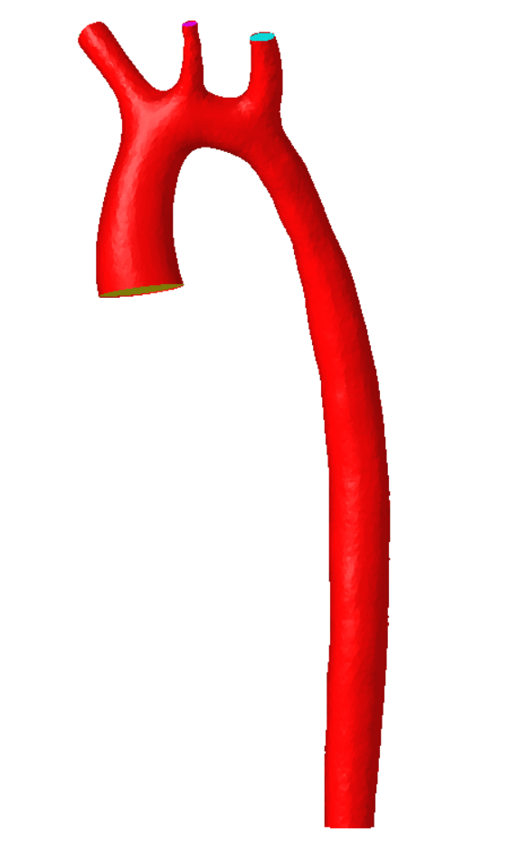
Future Work
Initial condition to be obtained after running simulations for many cycles
Initial velocity varies with time as per the graph shown below
Inlet
Table: Flow rate in inlet vs Velocity
Fig: Ascending Aorta
Table: Flow rate in inlet vs Velocity
Source: http://www.vascularmodel.org/miccai2013/

Slide 29
References
LBMHexMesh: an OpenFOAM based grid generator for the Lattice Boltzmann Method (LBM), Andrea Pasquali, Martin Schonherr, Martin Geier, Manfred Krafczyk

Slide 30
Thanks
Questions & Feedbacks

